Slide 1
ENHANCE THE PERFORMANCE OF WIRELESS SENSOR NETWORK USING ATTACK DETECTION SYSTEM
GUIDED BY BATCH MEMBERS
Dr .S.G.SUSILA 810020106058 - NARMIDHA.M
810020106061 - PARKAVI.P
810020106075 - REVATHY.B

Slide 2
INTRODUCTION
To achieve security, the network can be split into sectors, and mobile agents (MAs) can be used to reject traffic intruders caused by attacks taking into account energy constraint.
To evaluate the performance of our proposal, we have carried out several simulation tests using the NS2 simulator.

Slide 3
OBJECTIVE
This project is to evaluate the performance of WSN by Attack detection system through simulation tests using the NS2 simulator.
The Performance are
→Energy Consumption
→Throughput
→Delay

Slide 4
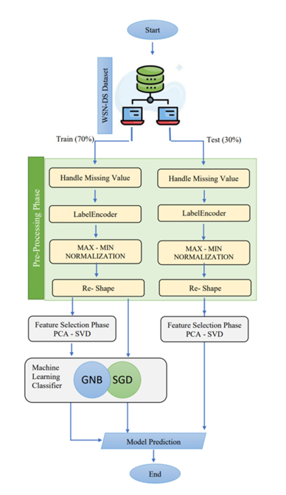
ALGORITHM FLOW

Slide 5
PROPOSED SYSTEM
As a result, different feature selection methods, such as principal component analysis (PCA) and singular value decomposition (SVD), were investigated in this paper concerning intrusion detection in WSNs.
The purpose of this research is to propose an intrusion detection model called SG-IDS by comparing and contrasting the performances of two different classification strategies: Stochastic Gradient Descent and Gaussian Naive Bayes under WSN.
To detect traffic attacks under a WSN with fewer false positives, an SG-IDS is utilized

Slide 6
PROPOSED MODEL DESCRIPTION
First, the input data, WSN-DS, was loaded.
A sequence of activities was then performed under well-defined hyper parameters.
Preprocessing with Principal Component Analysis (PCA) reduces dataset dimensionality, making feature extraction easier.
The data are then enhanced, and relevant properties are identified using Singular Value Decomposition (SVD).

Slide 7
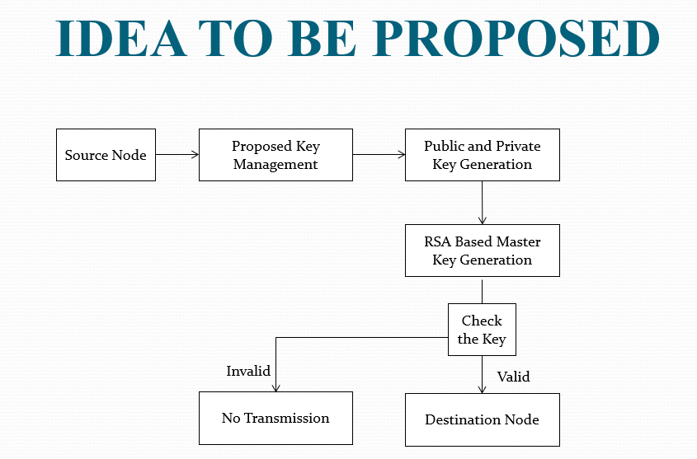

Slide 8
METRICS TO BE MEASURED
METRICS | QUALITATIVE | QUANTITATIVE
Throughput | Represents the efficiency of data transmission. | Measured in packets per second (pps).
Packet Delivery Ratio | Indicates the effectiveness of data delivery. | Calculated as the ratio of successfully received packets to the total number of packets sent.
Packet Drop Ratio | Reflects the rate of packet loss or inefficiency in data transmission. | Calculated as the ratio of dropped packets to the total number of packets sent.
Delay | Represents the time taken for data to travel from source to destination. | Measured in milliseconds (ms), indicating the time elapsed between the initiation of transmission and the actual reception.
Energy Consumption | Indicates the amount of energy required for data transmission. | Measured in joules, reflecting the energy expended during packet transmission.

Slide 9
LITERATURE SURVEY
S.N0 | TITLE | AUTHOR & YEAR | DESCRIPTION | MERITS | DEMERITS
1. | RDCM: AN EFFICIENT REAL TIME DATA COLLECTION MODEL FOR IOT /WSN EDGE WITH MULTIVARIATE SENSORS | Nayef Abdul wahab Mohammed Alduais 2019 | An efficient real-time data collection model for multivariate sensors in IoT/WSN applications named RDCM | RDCM has a very high performance in terms of energy consumption | WSN sensor boards are less reliable when the error rate is close to zero
2. | DESIGN AND ANALYSIS OF A PERSISTENT, EFFICIENT, AND SELF-CONTAINED WSN DATA COLLECTION SYSTEM | Wei Zhang , Jianfei Chang 2019 | The Random Feedback Digestion (RFDG) model to remove the symbols and reduce resource consumption by using the feedback information. | In data collection efficiency and reduce the delayed effect | Increase the burden of feedback messages, and also increase the total energy consumption of the network.

Slide 10
S.NO | TITLE | AUTHOR & YEAR | DESCRIPTION | MERITS | DEMERITS
3. | ADDING DUTY CYCLE ONLY IN CONNECTED DOMINATING SETS FOR ENERGY EFFICIENT AND FAST DATA COLLECTION | Weiwei Shi, Wei Liu 2019 | An adding Duty Cycle Only in Connected Dominating Sets approach is proposed, which can effectively reduce network energy consumption and delay. | Effectively reduce energy consumption and delay | ADCOCDS scheme has a good theoretical significance , not in practical as an effective data collection strategy.
4. | EFFICIENT ALGORITHMS FOR MOBILE SINK AIDED DATA COLLECTION FROM DEDICATED AND VIRTUAL AGGREGATION NODES IN ENERGY HARVESTING WSN | Lei Tao Weifa Liang 2019 | The mobile data collection problem in an energy harvesting wireless sensor network (EH-WSN), where sensor nodes are densely deployed in a monitoring area and a mobile sink | Deal with the reliable, stable, and energy neutral energy assignment for sensors. | Less efficient in dynamic optimization algorithm for mobile sink movement.

Slide 11
S.NO | TITLE | AUTHOR & YEAR | DESCRIPTION | MERITS | DEMERITS
5. | SUSTAINABLE AND EFFICIENT DATA COLLECTION FROM WSNS TO CLOUD | Tian Wang, Yang Li 2019 | WSNs to cloud within a limited time and this problem is proved to be NP-hard. To reduce the delivery latency caused by unreasonable task allocation. | WSNs to Cloud which makes the sensor-cloud sustainable. | WSNs to Cloud within the limited latency and optimize the energy consumption
6. | BIG DATA CHALLENGES AND DATA AGGREGATION STRATEGIES IN WIRELESS SENSOR NETWORKS | E.Boubiche A. Bilami 2018 | This paper proposed the distributed compressive data aggregation in large-scale wireless sensor networks | Better energy efficient clustering, processing, and securing | Less efficient and not suitable for heterogeneous wireless sensor networks

Slide 12
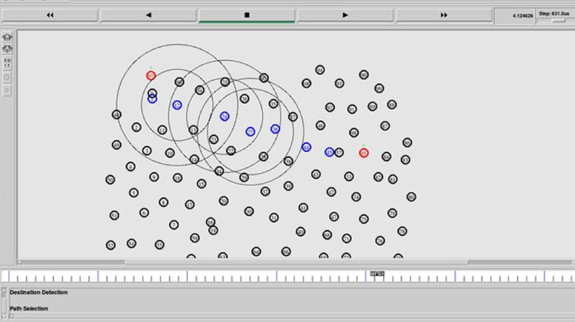
EXPECTED OUTCOME

Slide 13
SUB BLOCKS TO BE USED AND THEIR RESULTS

Slide 14
1. INITIALIZE GLOBAL NODE
2. OPEN THE NAM TRACE FILE
3. SET UP TOPOGRAPHY OBJECT
4. CONFIGURE NODE

Slide 15
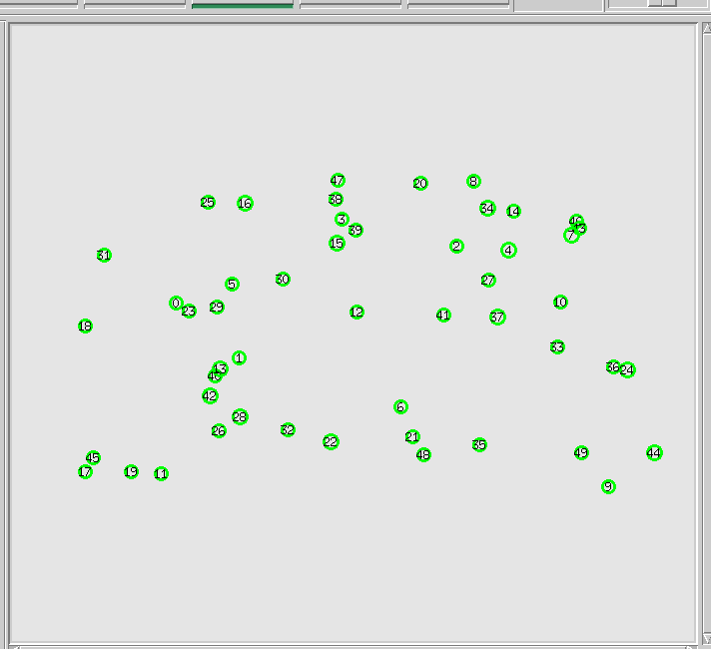
INITIALIZE GLOBAL NODE

Slide 16
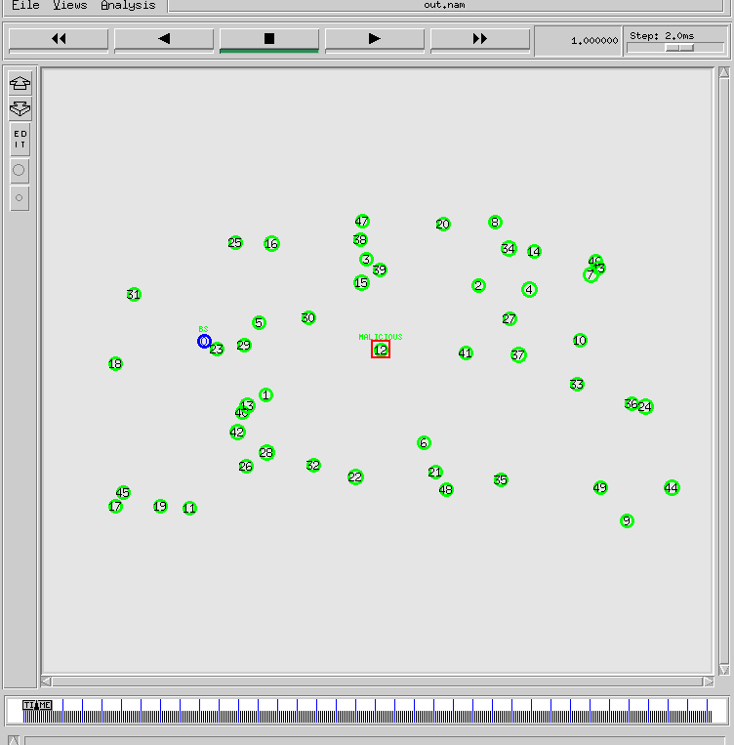
OPEN THE NAM TRACE FILE

Slide 17
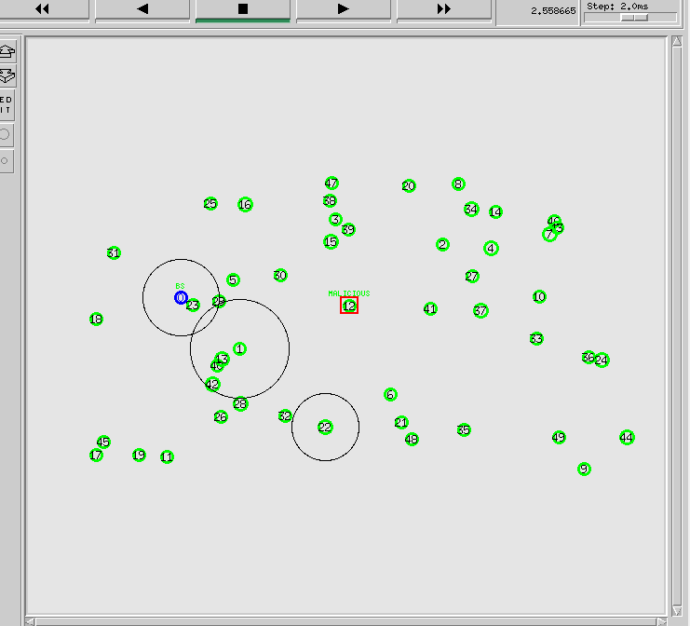
SET UP TOPOGRAPHY OBJECT

Slide 18
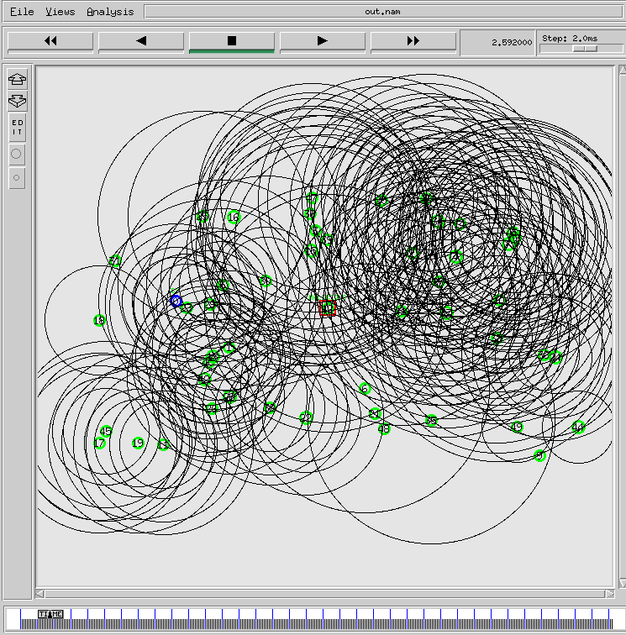
CONFIGURE NODE

Slide 19
SYSTEM REQUIREMENTS
Operating System : Windows 10 & Virtual Linux OS
Tool and Language : NS2/TCL
Processor : Any Intel or AMD x86/x64 processor
RAM : 2GB recommended
Disk Space :3–4GBfor a MATLAB typical installation

Slide 20
CONCLUSION
The ratio of data packets successfully delivered to destination nodes out of all the unique messages created.
In this module, the performance of the proposed energy and attack method is analyzed.

Slide 21
REFERENCES
S.Boubiche,D.E.Boubiche,A.Bilami,and H.Toral-Cruz, “Big data challenges and data aggregation strategies in wireless sensor networks,” IEEE Access, vol. 6, pp. 20558–20571, 2018.
A.De Bonis and U. Vaccaro, “-almost selectors and their applications to multiple-access communication,” IEEE Trans. Inf. Theory, vol. 63, no. 11, pp. 7304–7319, Nov. 2017.
C. Aksoylar, G. K. Atia, and V. Saligrama, “Sparse signal processing with linear and nonlinear observations: A unified Shannon-theoretic approach,” IEEE Trans. Inf. Theory, vol. 63, no. 2, pp. 749–776, Feb. 2017
C.-J. Liu, P. Huang, and L. Xiao, “TAS-MAC: A traffic-adaptive synchronous MAC protocol for wireless sensor networks,” ACM Trans. Sensor Netw., vol. 12, no. 1, p. 1, 2016.
S. Wu, S. Wei, Y. Wang, R. Vaidyanathan, and J. Yuan, “Partition information and its transmission over boolean multi-access channels,” IEEE Trans. Inf. Theory, vol. 61, no. 2, pp. 1010–1027, Feb. 2015.

Slide 22
THANK YOU

